Slide 1
Numpy
Python lıbrarıes for data scıence & machıne learnıng - ı

Slide 2
What is NumPy used for ?
NumPy (Numerical Python) is an open source Python library that’s used in almost every field of science and engineering. It’s the universal standard for working with numerical data in Python, and it’s at the core of the scientific Python and PyData ecosystems. NumPy users include everyone from beginning coders to experienced researchers doing state-of-the-art scientific and industrial research and development. The NumPy API is used extensively in Pandas, SciPy, Matplotlib, scikit-learn, scikit-image and most other data science and scientific Python packages.

Slide 3
What does NumPy Do ?
The NumPy library contains multidimensional array and matrix data structures (you’ll find more information about this in later sections). It provides ndarray, a homogeneous n-dimensional array object, with methods to efficiently operate on it. NumPy can be used to perform a wide variety of mathematical operations on arrays. It adds powerful data structures to Python that guarantee efficient calculations with arrays and matrices and it supplies an enormous library of high-level mathematical functions that operate on these arrays and matrices.

Slide 4
What does NumPy Do ?
NumPy gives you an enormous range of fast and efficient ways of creating arrays and manipulating numerical data inside them. While a Python list can contain different data types within a single list, all of the elements in a NumPy array should be homogeneous. The mathematical operations that are meant to be performed on arrays would be extremely inefficient if the arrays weren’t homogeneous.
Why use NumPy?
NumPy arrays are faster and more compact than Python lists. An array consumes less memory and is convenient to use. NumPy uses much less memory to store data and it provides a mechanism of specifying the data types. This allows the code to be optimized even further.

Slide 5
Numpy Arrays
An array is a central data structure of the NumPy library. An array is a grid of values and it contains information about the raw data, how to locate an element, and how to interpret an element. It has a grid of elements that can be indexed in various ways. The elements are all of the same type, referred to as the array dtype.
An array can be indexed by a tuple of nonnegative integers, by booleans, by another array, or by integers. The rank of the array is the number of dimensions. The shape of the array is a tuple of integers giving the size of the array along each dimension.

Slide 6
How to use Numpy library

Slide 7
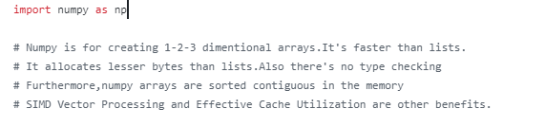
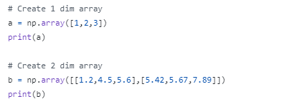
Importing Numpy
Creating an array

Slide 8


Getting the shapes of Arrays
Getting the types of Arrays

Slide 9

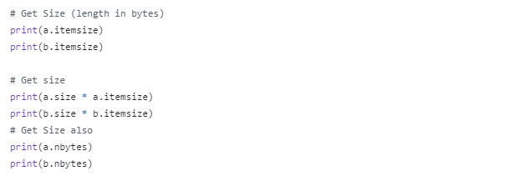
Specifying an Array’s dtype
Getting the size of arrays

Slide 10
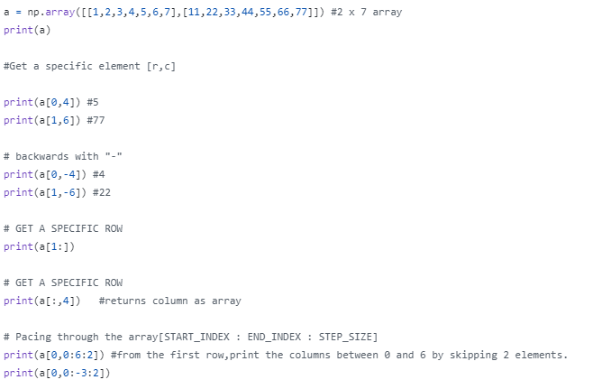
Accessing Specific parts of an array
Slicing

Slide 11
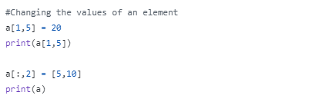
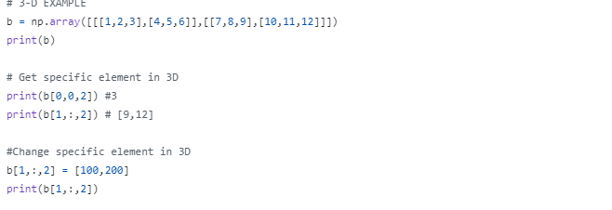
Changing a value(element) in an array
3-D Array

Slide 12
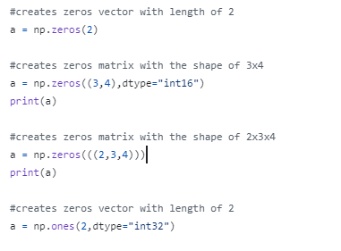
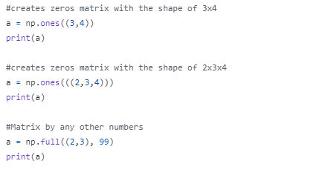
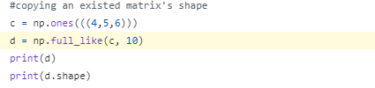
INITIALIZING DIFFERENT TYPE OF ARRAYS - MATRIXES
ONES

Slide 13
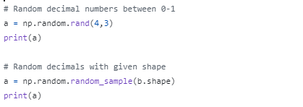

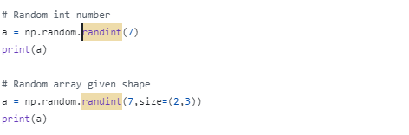
OPERATIONS USING RANDOM

Slide 14
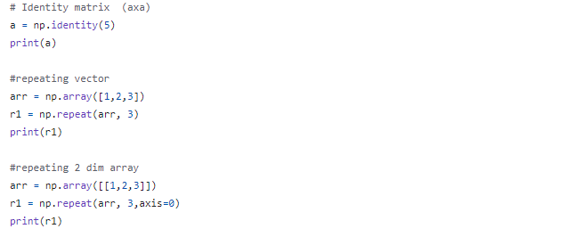
Some other matrix operations

Slide 15
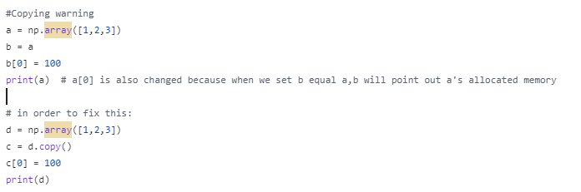
MEMORY ALLOCATION WARNING !

Slide 16

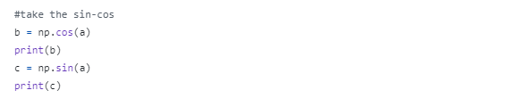
MATH OPERATIONS

Slide 17
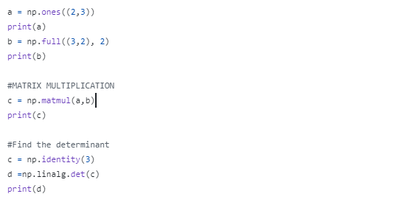
LINEAR ALGEBRA

Slide 18
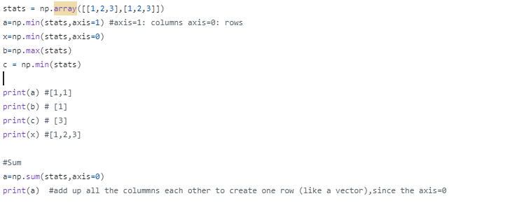
STATISTICS

Slide 19
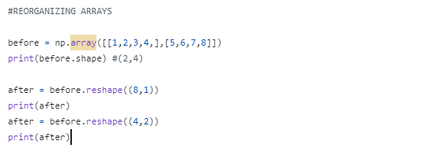
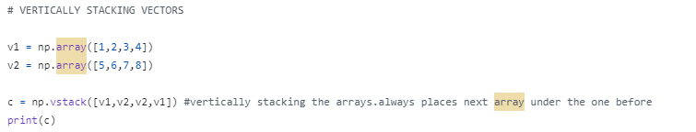
REGORGANIZING ARRAY

Slide 20
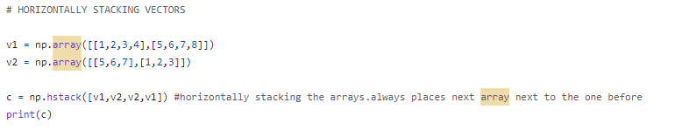
REORGANIZING ARRAY

Slide 21
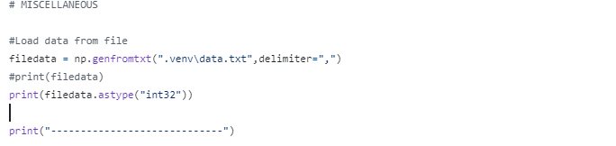
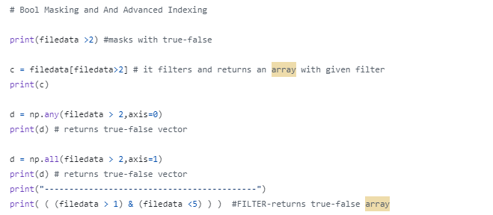
MISCALLENOUS

